Slide 1



Noida Institute of Engineering and Technology, Greater Noida
Introduction to Data Science
Unit: 1
Data Analytics ACSAI0512
Dr. Kumod Kumar Gupta
Assistant Professor
CSE-AI
B.Tech 5th Semester

Slide 2
Faculty Introduction
Name | Dr. Kumod Kumar Gupta
Qualification | PhD (Artificial Intelligence)
Designation | Assistant Professor
Department | CSE-AI
NIET Experience | 3 Years
Subject Taught | Data Analytics, Introduction to Artificial Intelligence, Social Media Analytics, Cyber Security

Slide 3
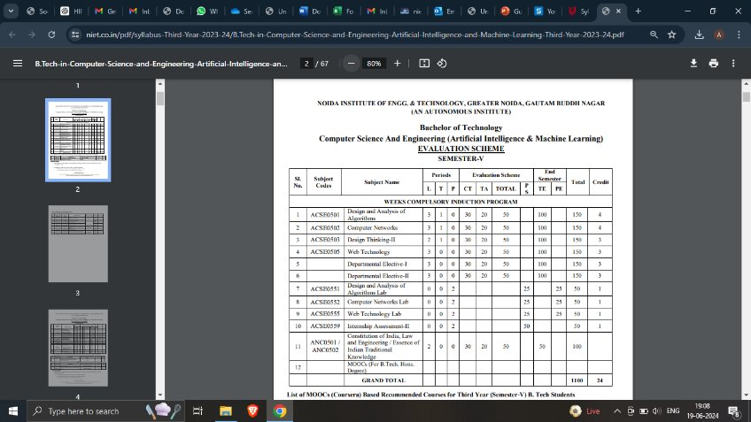
Evaluation Scheme

Slide 4
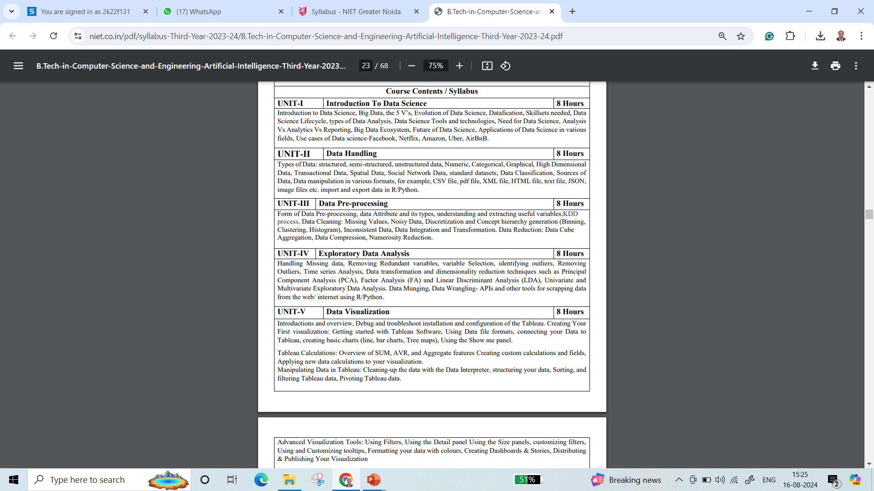
Syllabus

Slide 5
Syllabus
UNIT-I: Introduction to Data Science
Introduction to Data Science, Big Data, the 5 V’s, Evolution of Data Science, Datafication, Skillsets needed, Data Science Lifecycle, types of Data Analysis, Data Science Tools and technologies, Need for Data Science, Analysis Vs Analytics Vs Reporting, Big Data Ecosystem, Future of Data Science, Applications of Data Science in various fields, Use cases of Data science-Facebook, Netflix, Amazon, Uber, AirBnB.

Slide 6
Syllabus
UNIT-II: Data Handling
Type of Data: structured, semi-structured, unstructured data, Numeric, Categorical, Graphical, High Dimensional Data, Transactional Data, Spatial Data, Social Network Data, standard datasets, Data Classification, Sources of Data, Data manipulation in various formats, for example, CSV file, pdf file, XML file, HTML file, text file, JSON, image files etc. import and export data in R/Python.

Slide 7
Syllabus
UNIT-III: Data Preprocessing
Form of Data Pre-processing, data Attribute and its types, understanding and extracting useful variables,KDD process, Data Cleaning: Missing Values, Noisy Data, Discretization and Concept hierarchy generation (Binning, Clustering, Histogram), Inconsistent Data, Data Integration and Transformation. Data Reduction: Data Cube Aggregation, Data Compression, Numerosity Reduction

Slide 8
Syllabus
UNIT-IV: Exploratory Data Analysis
Handling Missing data, Removing Redundant variables, variable Selection, identifying outliers, Removing Outliers, Time series Analysis, Data transformation and dimensionality reduction techniques such as Principal Component Analysis (PCA), Factor Analysis (FA) and Linear Discriminant Analysis (LDA), Univariate and Multivariate Exploratory Data Analysis. Data Munging, Data Wrangling- APIs and other tools for scrapping data from the web/ internet using R/Python.

Slide 9
Syllabus
UNIT-V: Data Visualization
Introductions and overview, Debug and troubleshoot installation and configuration of the Tableau. Creating Your First visualization: Getting started with Tableau Software, Using Data file formats, connecting your Data to Tableau, creating basic charts (line, bar charts, Tree maps), Using the Show me panel. Tableau Calculations: Overview of SUM, AVR, and Aggregate Features Creating custom calculations and fields, Applying new data calculations to your visualization. Manipulating Data in Tableau: Cleaning-up the data with the Data Interpreter, structuring your data, Sorting, and filtering Tableau data, Pivoting Tableau data. Advanced Visualization Tools: Using Filters, Using the Detail panel Using the Size panels, customizing filters, Using and Customizing tooltips, Formatting your data with colours, Creating Dashboards & Stories, Distributing & Publishing Your Visualization

Slide 10
Branch Wise Applications
1.Security
2. Digital Advertising
3. E-Commerce
4. Publishing
5. Massively Multiplayer Online Games
6. Backend Services and Messaging
7. Project Management & Collaboration
8. Real time Monitoring Services
9.Live Charting and Graphing
10. Group and Private Chat

Slide 11
Course Objective
The objective of this course is to understand the fundamental concepts of Data analytics and learn about various types of data formats and their manipulations. It helps students to learn exploratory data analysis and visualization techniques in addition to R/Python/Tableau programming language.

Slide 12
Course Outcomes
At the end of course, the student will be able to:
Understand the fundamental concepts of data analytics in the areas that plays major role within the realm of data science.
Explain and exemplify the most common forms of data and its representations.
Understand and apply data pre-processing techniques.
Analyse data using exploratory data analysis.
Illustrate various visualization methods for different types of data sets and application scenarios.

Slide 13
Program Outcomes
Engineering Graduates will be able to:
PO1 : Engineering Knowledge
PO2 : Problem Analysis
PO3 : Design/Development of solutions
PO4 : Conduct Investigations of complex problems
PO5 : Modern tool usage
PO6 : The engineer and society

Slide 14
Program Outcomes
Engineering Graduates will be able to:
PO7 : Environment and sustainability
PO8 : Ethics
PO9 : Individual and teamwork
PO10 : Communication
PO11 : Project management and finance
PO12 : Life-long learning

Slide 15

CO-POs Mapping
CO.K | PO1 | PO2 | PO3 | PO4 | PO5 | PO6 | PO7 | PO8 | PO9 | PO10 | PO11 | PO12
CO1 | 2 | 2 | 2 | 3 | 3 | - | - | - | - | - | - | -
CO2 | 3 | 2 | 3 | 2 | 3 | - | - | - | - | - | - | -
CO3 | 3 | 2 | 3 | 2 | 3 | - | - | - | - | - | - | -
CO4 | 3 | 2 | 3 | 2 | 3 | - | - | - | - | - | - | -
CO5 | 3 | 2 | 3 | 3 | 3 | - | - | - | - | - | - | -
AVG | 2.8 | 2.0 | 2.8 | 2.4 | 3.0 | - | - | - | - | - | - | -

Slide 16
Program Specific Outcomes
S. No. | Program Specific Outcomes (PSO) | PSO Description
1 | PSO1 | Design innovative intelligent systems for the welfare of the people using machine learning and its applications.
2 | PSO2 | Demonstrate ethical, professional and team - oriented skills while providing innovative solutions in Artificial Intelligence and Machine Learning for life-long learning.

Slide 17
CO-PSOs Mapping
CO.K | PSO1 | PSO2 | PSO3 | PSO4
CO1 | 3 | - | - | -
CO2 | 3 | 2 | - | -
CO3 | 3 | 3 | - | -
CO4 | 3 | 3 | - | -
CO5 | 3 | 3 | - | -

Slide 18
Program Educational Objectives
Program Educational Objectives (PEOs) | PEOs Description
PEOs | Pursue higher education and professional career to excel in the field of Artificial Intelligence and Machine Learning.
PEOs | Lead by example in innovative research and entrepreneurial zeal for 21st century skills.
PEOs | Proactively provide innovations solutions for societal problems to promote life-long learning.
Aarushi Thusu ACSAI0622 Social Media Analytics Unit 5

Slide 19
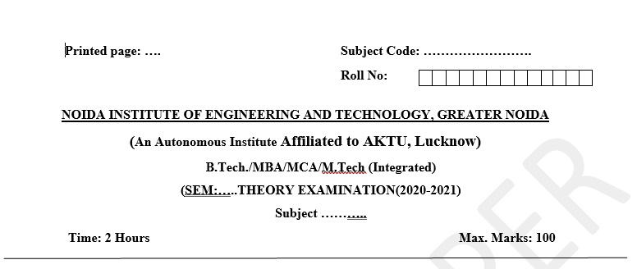
Pattern of External Exam Question Paper

Slide 20
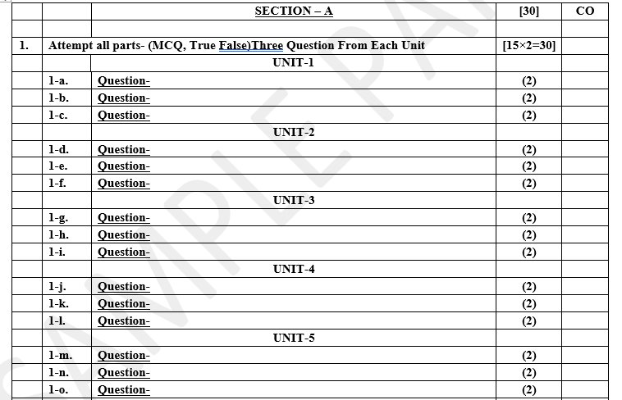
Pattern of External Exam Question Paper

Slide 21
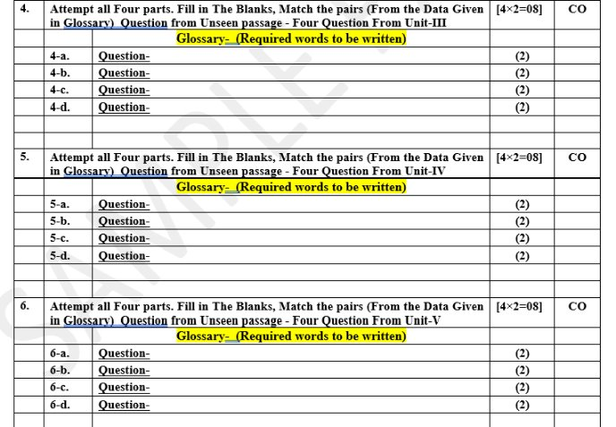
Pattern of External Exam Question Paper

Slide 22
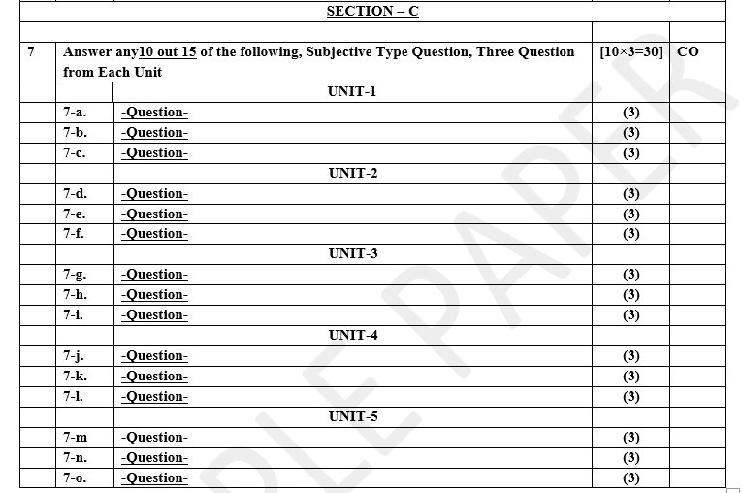
Pattern of External Exam Question Paper

Slide 23
Brief Introduction about the Subject and Videos
Data analytics (DA) is the area of examining data sets in order to find trends and draw conclusions about the information they contain. Increasingly, data analytics is done with the aid of specialized systems and software.
YouTube/other Video Links
https://www.youtube.com/watch?v=KxryzSO1Fjs

Slide 24
Unit Content
What is Data Science
Big Data, the 5 V’s
Evolution of Data Science
Datafication
Skill sets needed
Data Science Lifecycle
Types of Data Analysis
Data Science Tools and technologies
Need for Data Science
Analysis Vs Analytics Vs Reporting
Big Data Ecosystem
Future of Data Science
Applications of Data Science in various fields
Crowd sourcing analytics
Data Security Issues
Use cases of Data science-Facebook ,Netflix, Amazon, Uber, Airbnb.

Slide 25
Unit Objective
Understand the significance Data Science in Industry.
Understanding basic concept of Data Science implementation and its techniques.
Describe a formal definition to its frameworks.
Understanding the concept of Data Science in industry.
Understand the challenges faced by Data Science implementation process.
Describe the standards & requirements of implementing Data Science in cloud environment.

Slide 26
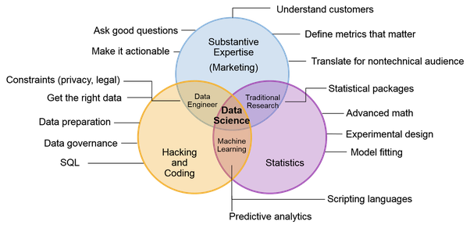
What is Data Science?
What is Data Science?
we use Data Science to find patterns in data and make meaningful, data-driven conclusions and predictions

Slide 27
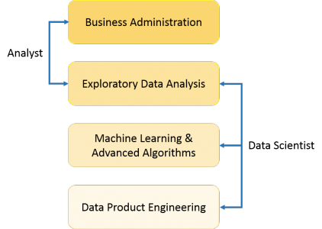
What is Data Science?
What is Data Science?

Slide 28
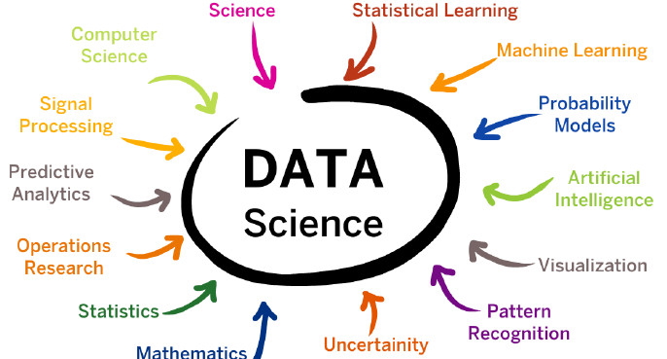
What is Data Science?
What is Data Science?

Slide 29
Data Science is a combination of multiple disciplines that uses statistics, data analysis, and machine learning to analyze data and to extract knowledge and insights from it. . By using Data Science, companies are able to make:
Better decisions (should we choose A or B)
Predictive analysis (what will happen next?)
Pattern discoveries (find pattern, or maybe hidden information in the data)
What is Data Science?

Slide 30
Where is Data Science Needed? Data Science is used in many industries in the world today, e.g. banking, consultancy, healthcare, and manufacturing. Examples where Data Science is needed: For route planning: To discover the best routes to ship
To foresee delays for flight/ship/train etc. (through predictive analysis)
To create promotional offers
To find the best suited time to deliver goods
To forecast the next years revenue for a company
To analyze health benefit of training
To predict who will win elections
What is Data Science?

Slide 31
How Does a Data Scientist Work?
A Data Scientist requires expertise in several backgrounds:
Machine Learning
Statistics
Programming (Python or R)
Mathematics
Databases
A Data Scientist must find patterns within the data. Before he/she can find the patterns, he/she must organize the data in a standard format.
What is Data Science?

Slide 32
How Does a Data Scientist Work?
Here is how a Data Scientist works:
Ask the right questions - To understand the business problem.
Explore and collect data - From database, web logs, customer feedback, etc.
Extract the data - Transform the data to a standardized format.
Clean the data - Remove erroneous values from the data.
Find and replace missing values - Check for missing values and replace them with a suitable value (e.g. an average value).
Normalize data - Scale the values in a practical range (e.g. 140 cm is smaller than 1,8 m. However, the number 140 is larger than 1,8. - so scaling is important).
Analyze data, find patterns and make future predictions.
Represent the result - Present the result with useful insights in a way the "company" can understand.
What is Data Science?

Slide 33
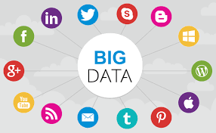
Big Data
This is a term related to extracting meaningful data by analyzing the huge amount of complex, variously formatted data generated at high speed, that cannot be handled, or processed by the traditional system.
Data which are very large in size is called Big Data.
Normally we work on data of size MB(Word Doc ,Excel) or maximum GB(Movies, Codes) but data in Peta bytes i.e. 10^15 byte size is called Big Data. It is stated that almost 90% of today's data has been generated in the past 3 years.

Slide 34
Sources Social networking sites: Facebook, Google, LinkedIn all these sites generates huge amount of data on a day to day basis as they have billions of users worldwide.
E-commerce site: Sites like Amazon, Flipkart, Alibaba generates huge amount of logs from which users buying trends can be traced.
Weather Station: All the weather station and satellite gives very huge data which are stored and manipulated to forecast weather.
Telecom company: Telecom giants like Airtel, Vodafone study the user trends and accordingly publish their plans and for this they store the data of its million users.
Share Market: Stock exchange across the world generates huge amount of data through its daily transaction.
Big Data

Slide 35
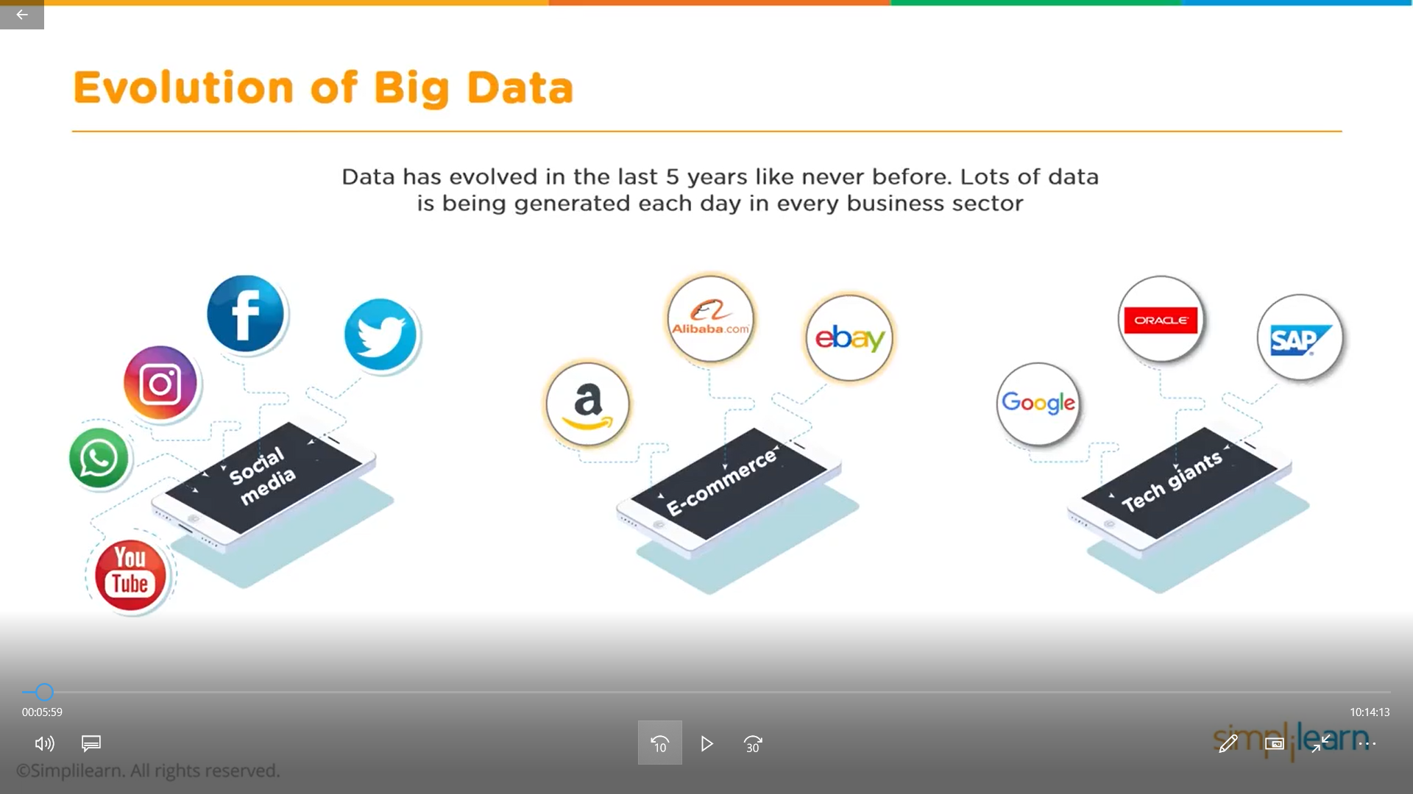
Big Data

Slide 36
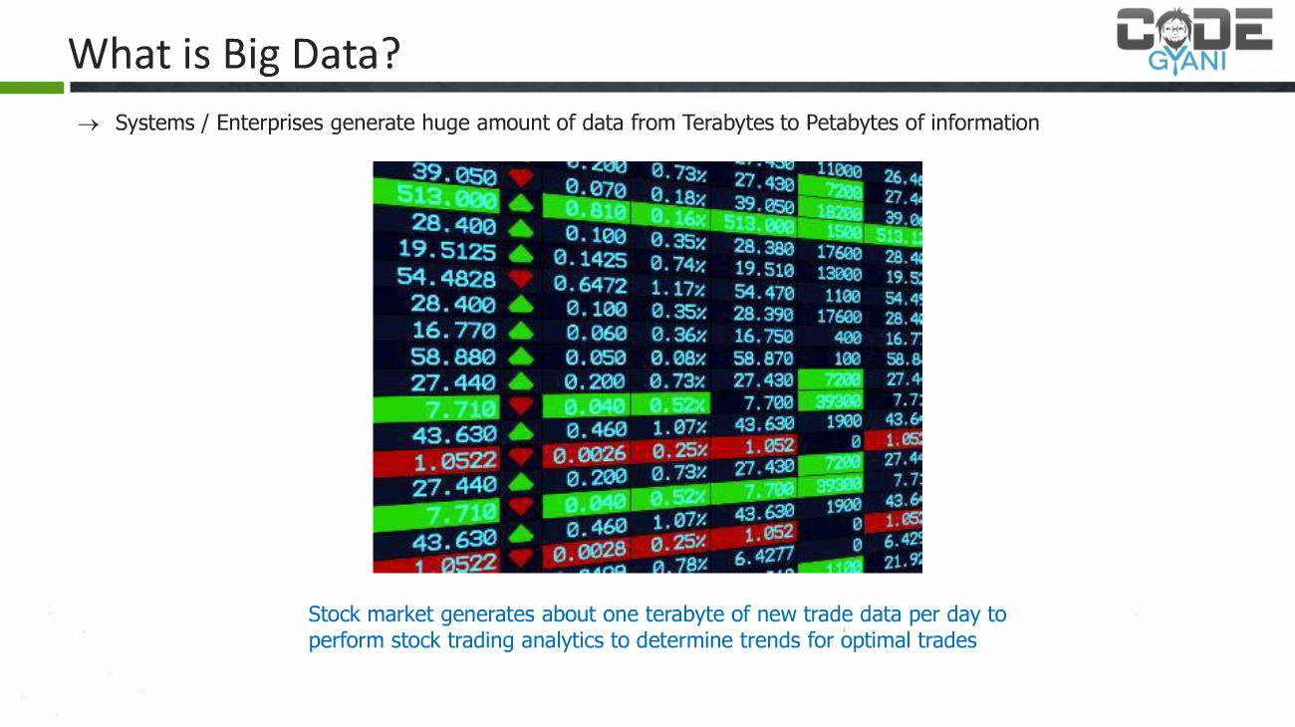
Big Data

Slide 37
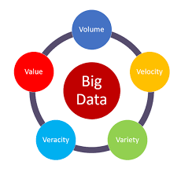
Big Data
5 Vs of Big Data:
The 5 V's of big data -- Velocity, Volume, Value, Variety and Veracity -- are the five main and innate characteristics of big data. Knowing the 5 V's lets data scientists derive more value from their data while also allowing their organizations to become more customer-centric.
Earlier this century, big data was talked about in terms of the three V's -- volume, velocity and variety. Over time, two more V's -- value and veracity -- were added to help data scientists more effectively articulate and communicate the important characteristics of big data.
In some cases, there's even a sixth V term for big data -- variability.

Slide 38
Big Data
The image represents the "5 Vs of Big Data," which typically include:
Volume: The amount of data generated.
Velocity: The speed at which data is generated and processed.
Variety: The different types of data (structured, unstructured, semi-structured).
Veracity: The quality or trustworthiness of the data.
Value: The usefulness of the data.
These five characteristics help in understanding the complexities and potential of big data.

Slide 39
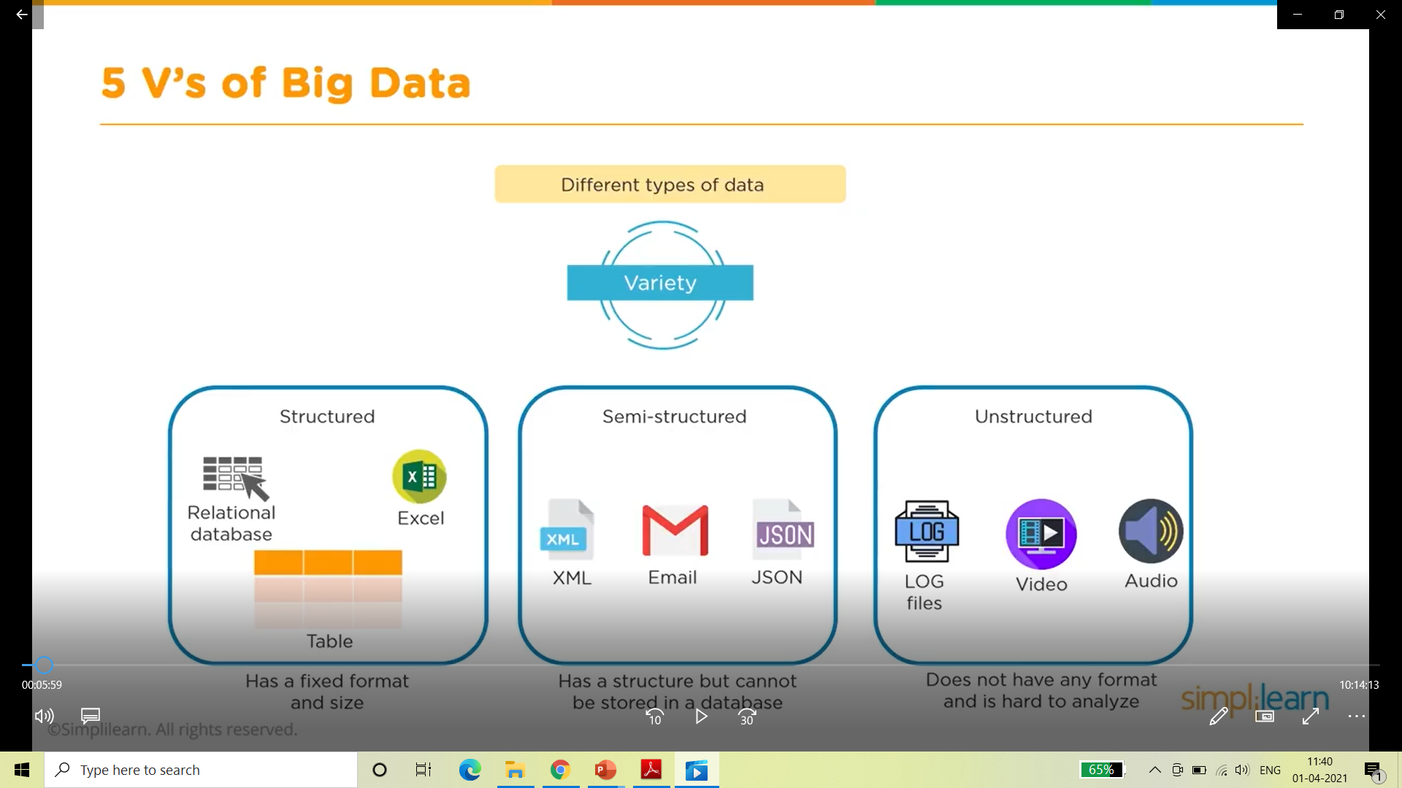
Big Data

Slide 40
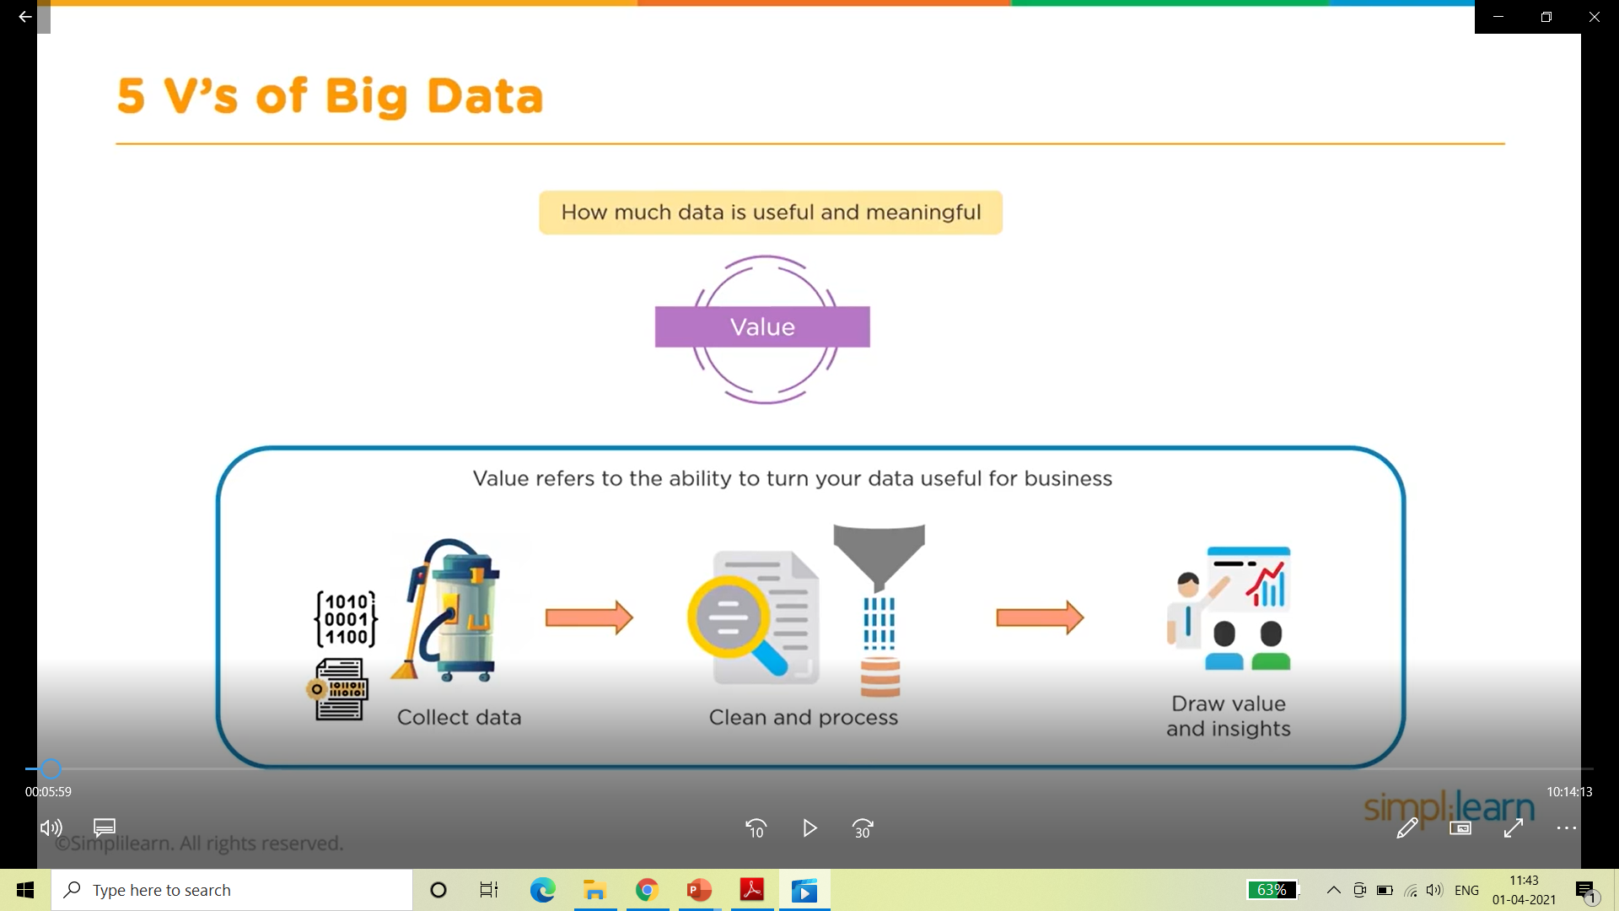
Big Data

Slide 41
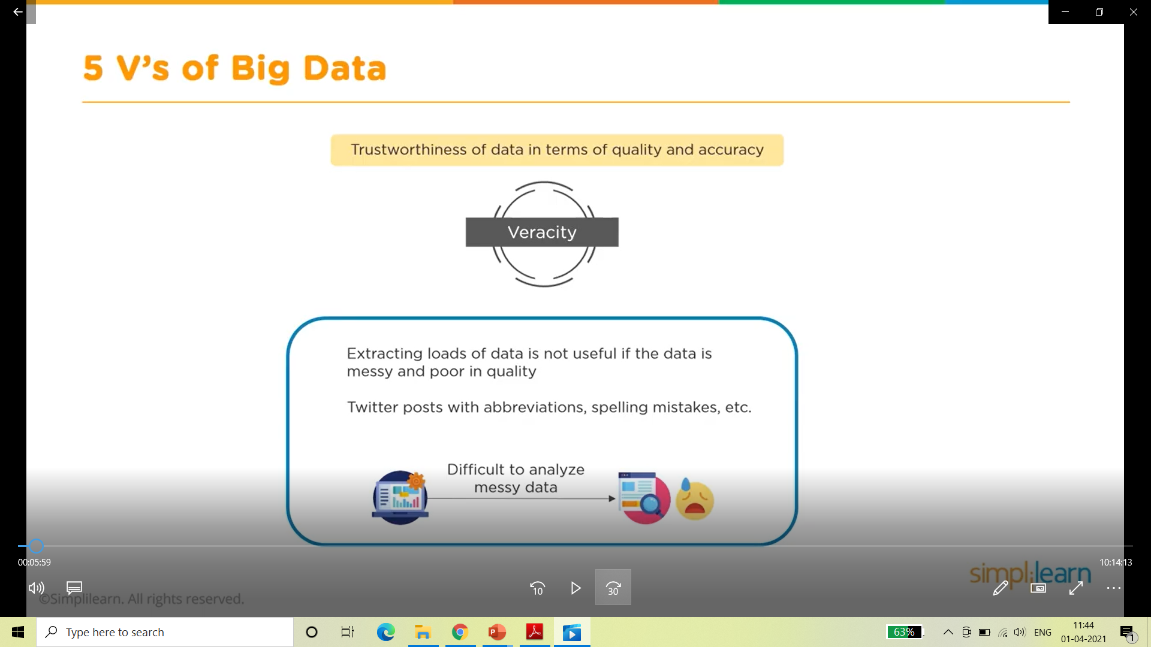
Big Data

Slide 42
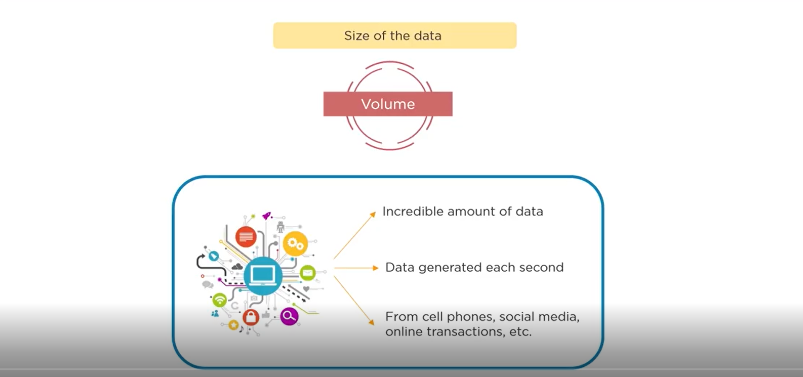
Big Data

Slide 43
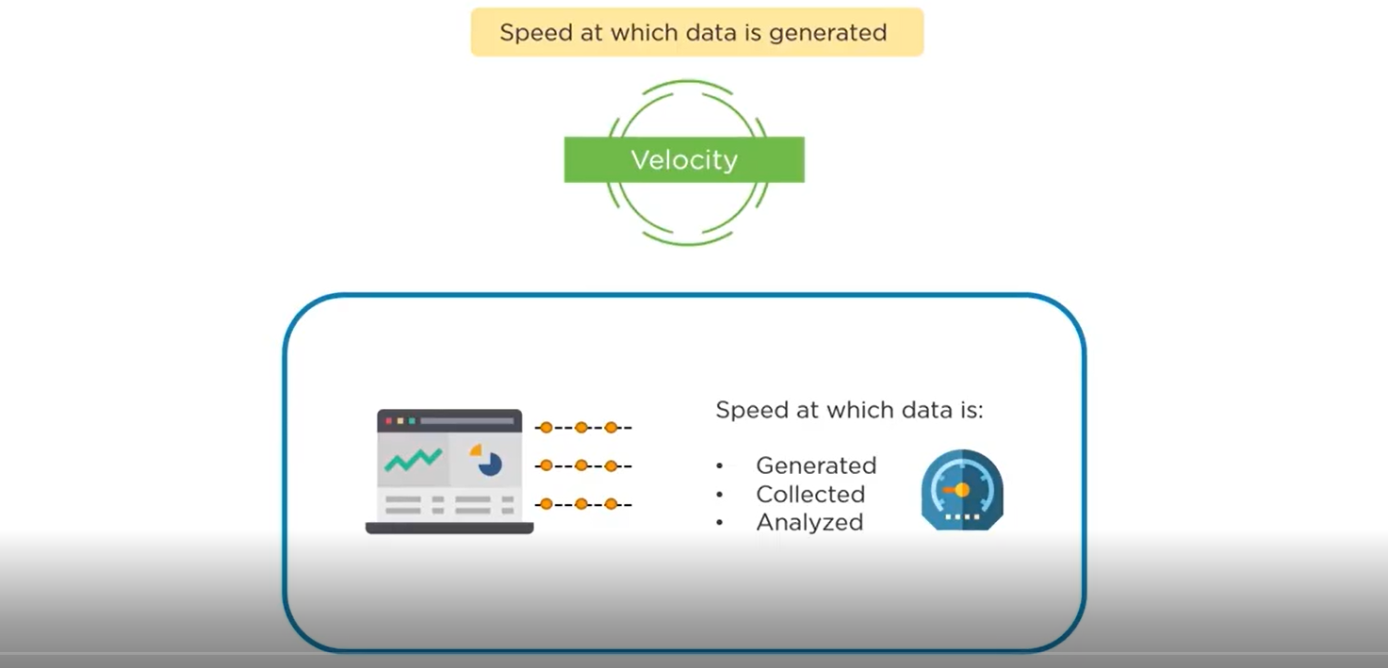
Big Data

Slide 44
Big Data
The sixth "V" added to the original five Vs of Big Data is Variability.
Variability refers to the changing nature of data, especially in the context of its meaning.
This includes the variations in data flow rates and formats, which can complicate data processing and analysis.
The concept of variability is crucial because it highlights the challenges posed by data that can be highly inconsistent, unpredictable, and dynamic.

Slide 45
Types of Digital Data
Process of classifying data in relevant categories so that it can be used or applied more efficiently.
The classification of data makes it easy for the user to retrieve it.
Data classification holds its importance when comes to data security and compliance and also to meet different types of business or personal objective.
It is also of major requirement, as data must be easily retrievable within a specific period of time.
We can further divide Data into three categories:
Structured Data
Unstructured Data
Semi Structured Data

Slide 46
Types of Digital Data
Structured Data :
Structured data is created using a fixed schema and is maintained in tabular format.
The elements in structured data are addressable for effective analysis.
It contains all the data which can be stored in the SQL database in a tabular format.
Today, most of the data is developed and processed in the simplest way to manage information.
Examples –
Relational data, Geo-location, credit card numbers, addresses, etc.
Consider an example for Relational Data like you have to maintain a record of students for a university like the name of the student, ID of a student, address, and Email of the student. To store the record of students used the following relational schema and table for the same.
ID | NAME | ADDRESS | EMAIL
101 | A | Delhi | A@gmail.com
102 | B | Mumbai | B@gmail.com

Slide 47
Types of Digital Data
Un Structured Data :
It is defined as the data in which is not follow a pre-defined standard or you can say that any does not follow any organized format.
This kind of data is also not fit for the relational database because in the relational database you will see a pre-defined manner or you can say organized way of data.
Unstructured data is also very important for the big data domain and To manage and store Unstructured data there are many platforms to handle it like No-SQL Database.
Examples –
Word, PDF, text, media logs, etc.

Slide 48
Types of Digital Data
Semi - Structured Data :
Semi-structured data is a type of data that is not purely structured, but also not completely unstructured. It contains some level of organization or structure, but does not conform to a rigid schema or data model
Example –
XML data
Characteristics of semi-structured Data:
Data does not conform to a data model but has some structure.
Data can not be stored in the form of rows and columns as in Databases
Semi-structured data contains tags and elements (Metadata) which is used to group data and describe how the data is stored
Similar entities are grouped together and organized in a hierarchy
Entities in the same group may or may not have the same attributes or properties
Does not contain sufficient metadata which makes automation and management of data difficult
Size and type of the same attributes in a group may differ
Due to lack of a well-defined structure, it can not used by computer programs easily

Slide 49
Evolution of Data Science
The field of data science has greatly transformed in recent times. Initially, it relied mostly on statistical analysis and data mining(the process of searching and analyzing a large batch of raw data in order to identify patterns and extract useful information) to draw conclusions based on structured data.
However, as big data technologies have expanded and increased the amount of unstructured information from sources such as social networks and sensors, this has made Data Science, which is related to massive data sets, even more demanding.
Modern technology and programming both in machine learning and artificial intelligence, have empowered Data Scientists.
They can now readily develop complex models for such tasks as predictive analytics, NLP and computer vision.
This has led to a hybrid of jobs such as within the health field, finance industry, but also retail and manufacturing industries.
They use it for things like personalized medicine, spotting fraud, suggesting products, and predicting when machines need fixing.

Slide 50
Evolution of Data Science
The evolution of Data Science over the years has taken form in many phases. It all started with Statistics. Simple statistics models were employed to collect, analyze and manage data since the early 1800s.
These principles underwent various modulations over time until the rise of the digital age. Once computers were introduced as mainstream public devices, there was a shift in the industry to the Digital Age.
A flood of data and digital information was created. This resulted in the statistical practices and models getting computerized giving rise to digital analytics.
Then came the rise of the internet that exponentially grew the data available giving rise to what we know as Big Data.
This explosion of information available to the masses gave rise to the need for expertise to process, manage, analyze and visualize this data for the purpose of decision making through the use of various models.
This gave birth to the term Data Science.

Slide 51
Datafication
Datafication, according to MayerSchoenberger and Cukier is the transformation of social action into online quantified data, thus allowing for real-time tracking and predictive analysis.
Simply said, it is about taking previously invisible process/activity and turning it into data, that can be monitored, tracked, analyzed and optimized.
Latest technologies we use have enabled lots of new ways of ‘datify’ our daily and basic activities.
Summarizing, datafication is a technological trend turning many aspects of our lives into computerized data using processes to transform organizations into data-driven enterprises by converting this information into new forms of value.
Datafication refers to the fact that daily interactions of living things can be rendered into a data format and put to social use.

Slide 52
Datafication
Let’s say social platforms, Facebook or Instagram, for example, collect and monitor data information of our friendships to market products and services to us and surveillance services to agencies which in turn changes our behavior; promotions that we daily see on the socials are also the result of the monitored data.
In this model, data is used to redefine how content is created by datafication being used to inform content rather than recommendation systems.
However, there are other industries where datafication process is actively used:
Insurance: Data used to update risk profile development and business models.
Banking: Data used to establish trustworthiness and likelihood of a person paying back a loan.
Human resources: Data used to identify e.g. employees risk-taking profiles.
Hiring and recruitment: Data used to replace personality tests.
Social science research: Datafication replaces sampling techniques and restructures the manner in which social science research is performed.

Slide 53
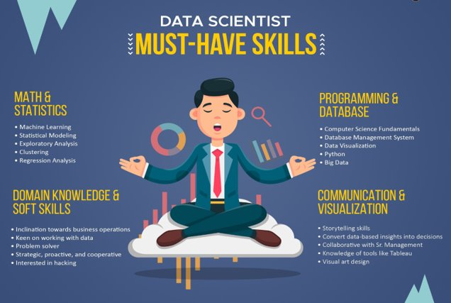
Skill Set Needed

Slide 54
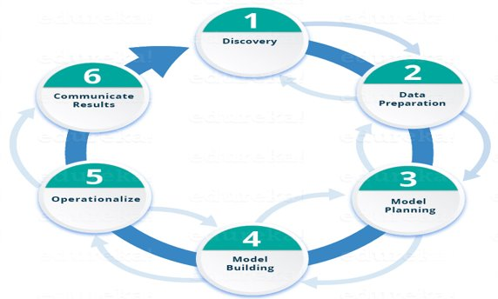
Data Science Life Cycle

Slide 55
Data Science Life Cycle
Phase 1—Discovery: Before you begin the project, it is important to understand the various specifications, requirements, priorities and required budget.
You must possess the ability to ask the right questions. Here, you assess if you have the required resources present in terms of people, technology, time and data to support the project.
In this phase, you also need to frame the business problem and formulate initial hypotheses (IH) to test.
Phase 2—Data preparation: In this phase, you require analytical sandbox in which you can perform analytics for the entire duration of the project.
You need to explore, preprocess and condition data prior to modeling. Further, you will perform ETLT (extract, transform, load and transform) to get data into the sandbox.
Let’s have a look at the Statistical Analysis flow below.
You can use R for data cleaning, transformation, and visualization. This will help you to spot the outliers and establish a relationship between the variables.
Once you have cleaned and prepared the data, it’s time to do exploratory analytics on it. Let’s see how you can achieve that.
Phase 3—Model planning: Here, you will determine the methods and techniques to draw the relationships between variables.
These relationships will set the base for the algorithms which you will implement in the next phase. You will apply Exploratory Data Analytics (EDA) using various statistical formulas and visualization tools.

Slide 56
Data Science Life Cycle
Phase 4—Model building: In this phase, you will develop datasets for training and testing purposes.
You will consider whether your existing tools will suffice for running the models or it will need a more robust environment (like fast and parallel processing).
You will analyze various learning techniques like classification, association and clustering to build the model.
Phase 5—Operationalize: In this phase, you deliver final reports, briefings, code and technical documents.
In addition, sometimes a pilot project is also implemented in a real-time production environment.
This will provide you a clear picture of the performance and other related constraints on a small scale before full deployment.
Phase 6—Communicate results: Now it is important to evaluate if you have been able to achieve your goal that you had planned in the first phase.
So, in the last phase, you identify all the key findings, communicate to the stakeholders and determine if the results of the project are a success, or a failure based on the criteria developed in Phase .

Slide 57
Data Science Tools and Technologies
Here are ten popular tools and technologies commonly used in data science:
1. Python
Why?: Python is the most widely used programming language in data science. It has a rich ecosystem of libraries like Pandas, NumPy, and Matplotlib that make data manipulation, analysis, and visualization easier.
2. R
Why?: R is another powerful programming language for data analysis and statistical computing. It's especially popular in academia and research.
3. Jupyter Notebooks
Why?: Jupyter Notebooks are a web-based interactive computing platform where you can write and run Python code, visualize data, and document your analysis in one place.

Slide 58
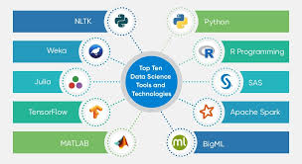
Data Science Tools and Technologies

Slide 59
Data Science Tools and Technologies
Pandas
Why?: Pandas is a Python library that provides data structures and functions needed to work with structured data, such as tables, efficiently.
5. TensorFlow
Why?: TensorFlow is an open-source deep learning framework developed by Google. It’s widely used for building machine learning models, particularly neural networks.
6. Scikit-learn
Why?: Scikit-learn is a Python library that provides simple and efficient tools for data mining and data analysis, including a variety of machine learning algorithms.
7. Tableau
Why?: Tableau is a powerful data visualization tool that allows you to create interactive and shareable dashboards, often used in business intelligence.

Slide 60
Data Science Tools and Technologies
SQL
Why?: SQL (Structured Query Language) is essential for managing and querying relational databases. It’s crucial for extracting and manipulating data stored in databases.
9. Apache Spark
Why?: Apache Spark is a fast, open-source data processing engine that can handle large-scale data processing and machine learning tasks across distributed systems.
10. Hadoop
Why?: Hadoop is an open-source framework that allows for the distributed processing of large data sets across clusters of computers. It’s commonly used for big data processing.
These tools and technologies form the backbone of modern data science workflows, helping professionals extract insights and build predictive models from data.

Slide 61
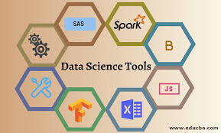
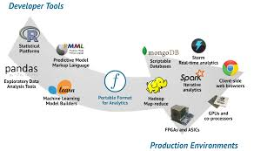
Data Science Tools and Technologies

Slide 62
Data Science Tools and Technologies
Following is the data science technology stack that is in demand and can come as necessary for a successful career in data science and technology.
Amazon Web Services (AWS)
Amazon Web Services (AWS) is a cloud provider. It is a cloud-based service that allows users to access virtual servers. The technology is offered through an Amazon Elastic Compute Cloud or EC2 instance. Instances are powered by Apache Spark on Amazon Linux and provide access to other services that may be used for data processing.
2. Amazon Machine Learning (AML)
Amazon Machine Learning is a specialized ML service inside AWS that can be used to develop ML models with predictive capabilities.
3. Text Mining
Nearly 80% of all data in the world is unstructured, making Text Mining a crucial analysis and processing method. It is the practice of extracting useful information and finding patterns from large amounts of textual material by organizing previously unrecognized relationships and trends.

Slide 63
Types of Data Analysis
Objective:
This unit objective is to specify that Data Analysis can be separated and organized into 6 types, arranged with an increasing order of difficulty as following types:
Descriptive Analysis
Exploratory Analysis
Inferential Analysis
Predictive Analysis
Causal Analysis
Mechanistic Analysis
Recap:
Revision of need of Data science in Industry.

Slide 64
Types of Data Analysis
Descriptive Analysis
What it is: Summarizes and describes the main features of a dataset.
Example: Calculating averages, percentages, or visualizing data with charts.
Purpose: Understand the basic characteristics of the data.
Example:
Take the COVID-19 statistics page on google for example, the line graph is just a pure summary of the cases/deaths, a presentation and description of the population of a particular country infected by the virus
Summary:
Descriptive Analysis is the first step in analysis where you summarize and describe the data you have using descriptive statistics, and its result is a simple presentation of your data.

Slide 65
Types of Data Analysis
2. Exploratory Analysis
What it is: Investigates data to find patterns, relationships, or anomalies.
Example: Identifying correlations between variables using scatter plots.
Purpose: Generate hypotheses and insights for further analysis.
Example:
Climate change is an increasingly important topic as the global temperature is gradually rising over the years.
One example of EDA on climate change is by taking the rise in temperature over the years, say 1950 to 2020 for example, and the increase of human activities and industrialization, and form relationships from the data, e.g. increasing number of factories, cars on the road and airplane flights increase correlates.
Summary:
EDA explores data to find relationships between measures that tells us they exist, without the cause. They can be used to formulate hypotheses

Slide 66
Types of Data Analysis
3. Inferential Analysis
What it is: Makes predictions or inferences about a population based on a sample.
Example: Estimating the average height of a population from a sample group.
Purpose: Generalize findings from a sample to a larger population.
Example:
The idea of inferring about the population at large with a smaller sample is quite intuitive, many statistics you see on the media and the internet are inferential, a prediction of an event based on a small sample. To give an example, a psychology study for the benefits of sleep, a total of 500 people involved in the study, when followed up with the candidates, they reported to have better overall attention and well-being with 7–9 hours of sleep, while those with less sleep and more sleep suffered with reduced attention and energy. This report from 500 people was just a tiny portion of 7b people in the world, thus an inference of the larger population.
Summary:
AI extrapolates and generalizes the information of the larger group with a smaller sample to generate analysis and predictions.

Slide 67
Types of Data Analysis
4. Predictive analysis
What it is: Uses historical data to predict future outcomes.
• Example: Forecasting sales for the next quarter based on past trends.
• Purpose: Anticipate future events or trends.
Example:
The 2020 US election is a popular topic and many prediction models are built to predict the winning candidate FiveThirtyEight did a great 2016 Election forecast and is back at it again in 2020. Prediction analysis for an election would require input variables such as historical polling data, trends and the current polling data in order to get a good prediction. Something as large as an election wouldn’t just be using a linear model, but a complex model with certain tunings to best serve it’s purpose.
Summary:
Predictive analysis takes data from the past and present to make predictions about the future.

Slide 68
Types of Data Analysis
5. Causal Analysis
What it is: Determines the cause-and-effect relationships between variables.
Example: Assessing whether a marketing campaign led to an increase in sales.
Purpose: Identify what factors cause specific outcomes.
Example: Say you want test out this new drug that improves human strength and focus, and to do that you perform randomized control trials for the drug to test the effect of the drug. You compare the sample of candidates for your new drug vs the candidates receiving mock control with a few test for on strength and overall focus and attention and observe how the drug affects the outcome
Summary: Causal Analysis is about finding out the causal relationship between variables, change one variable and what happens to another.

Slide 69
Types of Data Analysis
6. Mechanistic Analysis
What it is: Explains how variables influence each other in a system.
• Example: Understanding the biological pathways of a disease at the molecular level.
• Purpose: Understand the underlying mechanisms behind observed phenomena.
Example:
Many graduate-level research and complex topics are suitable examples, but to put it in a simple manner, let’s say an experiment is done to simulate safe and effective nuclear fusion to power the world, a mechanistic analysis of the study would entail precise balance of controlling and manipulating variables with highly accurate measures of both variables and the desired outcomes. It’s this intricate and meticulous modus operandi (strategy) towards these big topics that allows for scientific breakthroughs and advancement of society.
Summary:
MA is in some ways a predictive analysis, but modified to tackle studies that require high precision and meticulous methodologies for physical or engineering science.

Slide 70
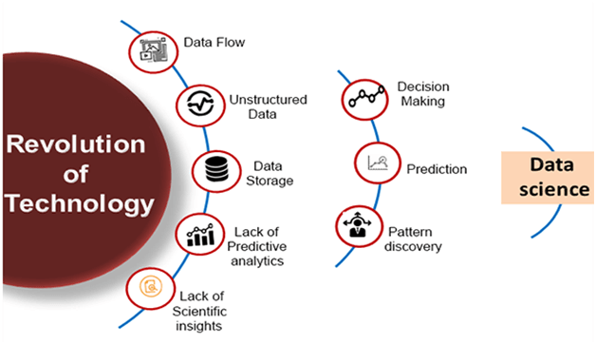
Need for Data Science

Slide 71
Need for Data Science
With the help of data science technology, we can convert the massive amount of raw and unstructured data into meaningful insights.
Data science technology is opting by various companies, whether it is a big brand or a startup. Google, Amazon, Netflix, etc, which handle the huge amount of data, are using data science algorithms for better customer experience.
Data science is working for automating transportation such as creating a self-driving car, which is the future of transportation.
Data science can help in different predictions such as various survey, elections, flight ticket confirmation, etc.

Slide 72
Analysis Vs Analytics
Analysis and Analytics are related but distinct concepts. Here's a simple explanation of each:
Analysis
Definition: Analysis is the process of examining data in detail to draw conclusions or insights. It often involves breaking down complex data into smaller, understandable parts.
Focus: It is more about understanding what happened or is happening by interpreting data.
Example: Analyzing sales data to understand why sales dropped in a particular month.
Analytics
Definition: Analytics involves the systematic use of data and statistical methods to find patterns, make predictions, or inform decisions. It can include various types of analysis, but it often goes beyond just understanding the past or present.
Focus: It is broader and includes tools, techniques, and algorithms to process data and predict future trends.
Example: Using predictive analytics to forecast future sales based on historical data.

Slide 73
Analysis Vs Analytics
Key Differences
Scope: Analysis is typically more focused on explaining past data, while analytics can also include predictive models and simulations to forecast future events.
Techniques: Analysis might use simple statistical methods, whereas analytics often involves advanced algorithms, machine learning, and data mining techniques.

Slide 74
Analytics Vs Reporting
Analytics and Reporting are both crucial aspects of data-driven decision-making, but they serve different purposes:
Reporting
Definition: Reporting involves collecting data from various sources, organizing it, and presenting it in a structured format (like tables, charts, or dashboards). The goal is to provide a snapshot of current or historical data.
Focus: It focuses on summarizing and visualizing data to communicate what has happened.
Example: A monthly sales report that shows total sales, broken down by region or product, to give an overview of business performance.
Analytics
Definition: Analytics goes a step further by not just presenting data but also interpreting it. It uses statistical methods, algorithms, and machine learning to discover patterns, trends, and insights from the data.
Focus: The focus is on understanding why things are happening, predicting future trends, and making data-driven decisions.
Example: Analyzing customer behavior to predict which products will be popular next month, allowing a company to adjust its marketing strategy accordingly.

Slide 75
Analytics Vs Reporting
Key Differences
Purpose: Reporting provides a clear picture of what is happening in the business, while analytics aims to understand why it is happening and what could happen next.
Timeframe: Reporting is usually focused on past and present data, whereas analytics can be forward-looking, using past data to predict future outcomes.
Tools: Reporting may use simple tools like Excel or basic dashboards, whereas analytics often involves more sophisticated tools like data mining software, statistical analysis programs, or machine learning platforms.

Slide 76
Analysis Vs Analytics Vs Reporting
Analytics and reporting can help a business improve operational efficiency and production in several ways.
Analytics is the process of making decisions based on the data presented, while reporting is used to make complicated information easier to understand. Let’s discuss analytics vs reporting.
Analytics and reporting are often referred to as the same. Although both take in data as input and present it in charts, graphs, or dashboards, they have several key differences.

Slide 77
Analysis Vs Analytics Vs Reporting
Next-generation analytics uses new technologies like AI or machine learning to make predictions about the future based on past and present data.
The steps involved in data analytics are as follows:
Developing a data hypothesis
Data collection and transformation
Creating analytical research models to analyze and provide insights
Utilization of data visualization, trend analysis, deep dives, and other tools.
Making decisions based on data and insights

Slide 78
Analysis Vs Analytics Vs Reporting
In general, the procedures needed to create a report are as follows:
Determining the business requirement
Obtaining and compiling essential data
Technical data translation
Recognizing the data context
Building dashboards for reporting
Providing real-time reporting
Allowing users to dive down into reports

Slide 79
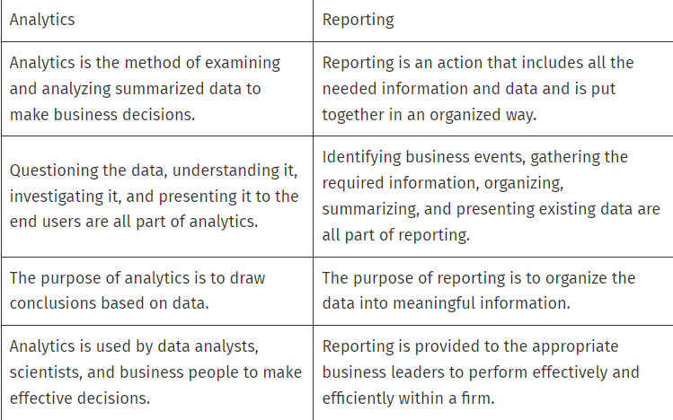
Analysis Vs Analytics Vs Reporting

Slide 80
Big Data Eco-System
The "Big Data Ecosystem" refers to the comprehensive environment that supports the storage, processing, analysis, and visualization of large volumes of data, often in real-time.
It involves various tools, technologies, and processes that work together to manage and extract value from big data.
Key components typically found in a Big Data Ecosystem include:
Data Sources:
Structured Data: Data from databases, spreadsheets, etc.
Unstructured Data: Text, images, videos, social media content.
Semi-Structured Data: JSON, XML, etc.
Data Storage:
Distributed File Systems: Like Hadoop Distributed File System (HDFS).
NoSQL Databases: Such as MongoDB, Cassandra.
Data Lakes: Large storage repositories that hold raw data.

Slide 81
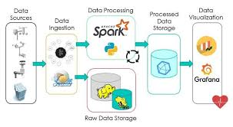
Big Data Eco-System

Slide 82
Big Data Eco-System
Data Processing:
Batch Processing: Using tools like Apache Hadoop for processing large datasets over time.
Real-Time Processing: With tools like Apache Spark or Apache Storm to handle data as it arrives.
Data Analysis:
Machine Learning: Algorithms that allow systems to learn and make decisions based on data.
Data Mining: Techniques to discover patterns and relationships in large datasets.
Statistical Analysis: Tools like R and Python for analyzing data.
Data Integration:
ETL Tools (Extract, Transform, Load): Such as Apache Nifi, Talend.
Data Ingestion: Collecting and importing data from various sources.
Data Visualization:
BI Tools (Business Intelligence): Like Tableau, Power BI.
Custom Dashboards: Developed with tools like D3.js, or Python libraries like Matplotlib.

Slide 83
Big Data Eco-System
Data Security:
Encryption: Protecting data at rest and in transit.
Access Control: Ensuring only authorized users can access data.
Data Governance:
Data Quality: Ensuring data is accurate and reliable.
Compliance: Adhering to regulations like GDPR(general Data protection regulation).
Cloud Services:
Infrastructure as a Service (IaaS): Like AWS, Google Cloud, Microsoft Azure.
Platform as a Service (PaaS): Such as Google BigQuery, Amazon Redshift.
Each of these components plays a critical role in managing the vast and complex data flows that constitute the big data environment. Together, they allow organizations to make informed decisions, gain insights, and create value from data.

Slide 84
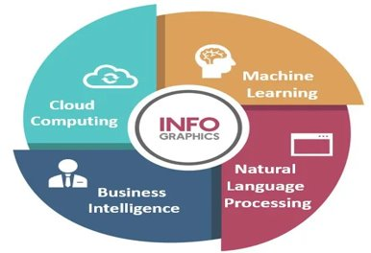
Big Data Importance and Applications
Main Technology Components Of Big Data:
Data Management​
2. Data Mining​
3. Hadoop​
4. In-Memory Analytics​
5. Predictive Analytics​
6. Text Mining​
Why is big data concepts analytics important?
Reduced cost
2. Quick decision making
3. New products and features

Slide 85
Big Data Importance and Applications
Data miming
Data mining is the process of extracting knowledge or insights from large amounts of data using various statistical and computational techniques.
The data can be structured, semi-structured or unstructured, and can be stored in various forms such as databases, data warehouses, and data lakes.
The primary goal of data mining is to discover hidden patterns and relationships in the data that can be used to make informed decisions or predictions.
This involves exploring the data using various techniques such as clustering, classification, regression analysis, association rule mining, and anomaly detection.
Data mining has a wide range of applications across various industries, including marketing, finance, healthcare, and telecommunications.
For example, in marketing, data mining can be used to identify customer segments and target marketing campaigns,
while in healthcare, it can be used to identify risk factors for diseases and develop personalized treatment plans.

Slide 86
Big Data Importance and Applications
Hadoop
Hadoop is an open-source framework used for storing and processing large data sets across clusters of computers.
It is designed to scale from a single server to thousands of machines, each offering local computation and storage.
Text mining
Text mining, also known as text data mining, is the process of transforming unstructured text into a structured format to identify meaningful patterns and new insights.

Slide 87
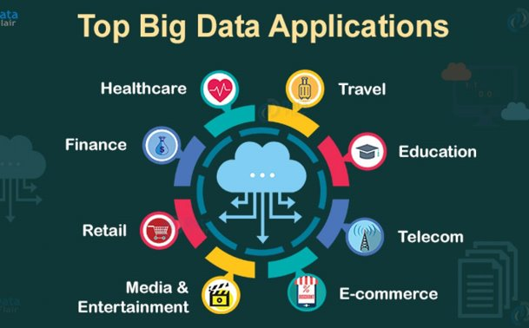
Applications of Big Data

Slide 88
Future of Data Science
The future of data science looks bright, with many exciting developments on the horizon. Here are some key trends and predictions for the field:
Increased Automation: Tools like AutoML (Automated Machine Learning) and AI-driven data platforms will simplify many aspects of data science, from data cleaning to model selection, making it accessible to non-experts.
AI Integration: Data science and AI will continue to merge, allowing for more powerful predictive models and decision-making tools in industries like healthcare, finance, and marketing.
Ethics and Explainability: As AI becomes more common, there will be a greater focus on ethical AI, ensuring models are fair, transparent, and explainable. This is important for building trust with users and avoiding bias.
Real-Time Data Processing: The need for real-time analysis will grow, especially in sectors like e-commerce, financial trading, and IoT (Internet of Things). Stream processing tools like Apache Kafka will become more prominent.

Slide 89
Future of Data Science
Data Privacy and Security: With growing data regulations (like GDPR), data scientists will need to prioritize privacy and security, developing techniques to handle sensitive information responsibly.
Domain-Specific Solutions: Specialized data science solutions tailored to industries such as healthcare, agriculture, and manufacturing will increase, focusing on solving unique problems within each field.
Quantum Computing: While still in early stages, quantum computing could revolutionize data science by solving complex problems that are currently impossible for classical computers.

Slide 90
Healthcare: Data science can identify and predict disease and personalize healthcare recommendations.
Transportation: Data science can optimize shipping routes in real-time.
Sports: Data science can accurately evaluate athletes’ performance.
Government: Data science can prevent tax evasion and predict incarceration rates.
E-commerce: Data science can automate digital ad placement.
Gaming: Data science can improve online gaming experiences.
Social media: Data science can create algorithms to pinpoint compatible partners.
Fintech: Data science can help create credit reports and financial profiles, run accelerated underwriting and create predictive models based on historical payroll data.
Applications of Data Science in Various Fields

Slide 91
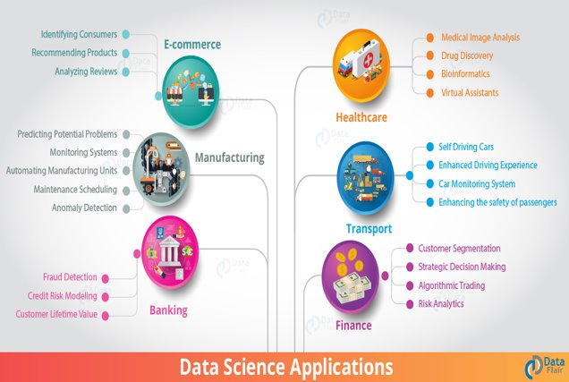
Applications of Data Science

Slide 92
Use-Cases of Data Science : NETFLIX
Netflix
Netflix uses data science extensively to enhance user experience, improve content, and optimize its operations. Here are some key use cases:
1. Personalized Recommendations
Netflix's recommendation engine is powered by data science algorithms that analyze user preferences. It collects data on what shows/movies you watch, how long you watch, and even what you search for. Using machine learning, Netflix predicts what content you'll likely enjoy and suggests shows or movies to keep you engaged.
Example: If you watch a lot of science fiction movies, Netflix will recommend more movies in that genre.
2. Content Creation and Investment Decisions
Netflix uses data science to decide what types of content to produce or license. By analyzing user behavior and trends, they can predict which shows or genres will be successful and where to invest their money.
Example: Netflix created House of Cards based on insights that political dramas were highly engaging for certain audiences.

Slide 93
Use-Cases of Data Science : NETFLIX
Optimizing Streaming Quality
Data science helps Netflix optimize the quality of video streaming based on your internet speed. It analyzes network conditions in real time and adjusts video resolution to ensure smooth playback without buffering.
Example: If your internet speed fluctuates, Netflix will automatically lower the video resolution to avoid interruptions.
4. Reducing Subscriber Churn
Data science helps Netflix identify users who might stop their subscriptions. By analyzing user data, they can detect patterns that show when someone is likely to leave (e.g., watching less content). Netflix can then take action, such as recommending new content to keep them engaged.
Example: If you haven't watched anything in a while, Netflix might send you personalized emails with content suggestions.

Slide 94
Use-Cases of Data Science : NETFLIX
A/B Testing
Netflix frequently runs A/B tests to improve its interface, features, and user experience. They use data science to analyze which version of a feature performs better in terms of engagement and satisfaction.
Example: Netflix may test different layouts or button placements to see which one makes users watch more content.
6. Pricing Strategy
Data science helps Netflix set its subscription prices by analyzing market trends, competitor pricing, and user data. This allows them to find the optimal balance between affordability and profitability.
Example: Netflix may adjust its pricing in different countries based on user demand and economic conditions.

Slide 95
Use-Cases of Data Science: UBER
Uber
Uber uses data science in many ways to improve its services, optimize operations, and enhance the rider and driver experience. Here are some key use cases:
1. Dynamic Pricing (Surge Pricing)
Uber uses data science algorithms to adjust prices based on demand and supply. When demand for rides is high (e.g., during rush hours or bad weather), the price goes up, and when demand is low, the price goes down. This helps balance the number of available drivers and riders.
Example: If there are more people requesting rides than available drivers, Uber increases prices (surge pricing) to encourage more drivers to get on the road.
2. ETA (Estimated Time of Arrival) Prediction
Uber uses data science to calculate the estimated time of arrival for rides. By analyzing historical traffic patterns, current traffic conditions, and GPS data, Uber provides accurate predictions of how long a driver will take to reach a rider and how long the ride will take to the destination.
Example: If you're going to the airport, Uber's app tells you exactly when the car will arrive and how long the trip will take.

Slide 96
Use-Cases of Data Science: UBER
Route Optimization
Uber uses data science to find the best and fastest routes for drivers. The system analyzes real-time traffic data, road conditions, and driver locations to suggest the most efficient route. This saves time and fuel, improving both the rider’s experience and the driver’s earnings.
Example: If there’s heavy traffic on the usual route, Uber’s system will reroute the driver to a less congested road.
4. Matching Riders with Drivers
Uber’s algorithms match riders with nearby drivers in the most efficient way possible. It considers factors like the driver’s current location, rider demand, and driver preferences to minimize waiting time for both parties.
Example: Uber’s algorithm might pair you with a driver who is just a few minutes away, instead of one who is farther, reducing your wait time.

Slide 97
Use-Cases of Data Science :UBER
Fraud Detection
Uber uses data science to detect and prevent fraudulent activities such as fake accounts, fraudulent payments, or false ride requests. Machine learning algorithms analyze patterns of normal and abnormal behavior, flagging anything that seems suspicious.
Example: If someone repeatedly cancels rides or requests multiple rides with strange patterns, Uber’s system will flag and investigate it.
6. Driver Incentives
Uber uses data science to create incentive programs that encourage drivers to work more during peak hours or in high-demand areas. These incentives are based on demand predictions, helping Uber ensure enough drivers are available when needed.
Example: During big events like concerts, Uber might offer bonuses to drivers to encourage them to drive in that area, ensuring there are enough cars for all the people needing rides.
7. Customer Support and Feedback
Uber analyzes rider and driver feedback to improve its services. Data science helps Uber identify patterns in complaints, suggestions, and ratings, allowing them to address common issues, improve user experience, and even personalize interactions.
Example: If many users in a certain city complain about long wait times, Uber may analyze this data to adjust how drivers are dispatched in that area.

Slide 98
Use-Cases of Data Science: UBER
Safety Features
Uber uses data science to enhance the safety of riders and drivers. For example, Uber’s system can detect unusual behavior, like a ride taking an unusually long route, and trigger safety alerts. They also use data to analyze past incidents and implement preventive measures.
Example: If a ride stops unexpectedly for too long or goes far off course, Uber might alert the rider and driver, offering them the option to trigger a safety check.
9. Uber Pool (Ride Sharing)
Uber Pool, the carpooling service, relies on data science to match multiple riders going in the same direction. Uber uses algorithms to find the most efficient combination of riders and routes, ensuring everyone reaches their destination with minimal detours.
Example: If you and another rider are both headed downtown, Uber Pool might group you together in one car, optimizing the trip for both.

Slide 99
Facebook – Using Data to Revolutionize Social Networking & Advertising
Facebook is a social-media leader of the world today. With millions of users around the world, Facebook utilizes a large scale quantitative research through data science to gain insights about the social interactions of the people.
Facebook has become a hub of innovation where it has been using advanced techniques in data science to study user behavior and gain insights to improve their product. Facebook makes use of advanced technology in data science called deep learning.
Using deep learning, Facebook makes use of facial recognition and text analysis. In facial recognition, Facebook uses powerful neural networks to classify faces in the photographs. It uses its own text understanding engine called “DeepText” to understand user sentences.
It also uses Deep Text to understand people’s interest and aligning photographs with texts.
However, more than being a social media platform, Facebook is more of an advertisement corporation. It uses deep learning for targeted advertising. Using this, it decides what kind of advertisements the users should view.
It uses the insights gained from the data to cluster users based on their preferences and provides them with the advertisements that appeal to them.
Use-Cases of Data Science

Slide 100
Since its inception, Amazon has been working hard to make itself a customer-centric platform. Amazon heavily relies on predictive analytics to increase customer satisfaction. It does so through a personalized recommendation system.
This recommendation system is a hybrid type that also involves collaborative filtering which is comprehensive in nature. Amazon analyzes the historical purchases of the user to recommend more products.
This also comes through the suggestions that are drawn from other users who use similar products or provide similar ratings.
Amazon has an anticipatory shipping model that uses big data for predicting the products that are most likely to be purchased by its users. It analyzes the pattern of your purchases and sends products to your nearest warehouse which you may utilize in the future.
Amazon also optimizes the prices on its websites by keeping in mind various parameters like the user activity, order history, prices offered by the competitors, product availability, etc. Using this method, Amazon provides discounts on popular items and earns profits on less popular items.
Another area where every e-commerce platform is addressing is Fraud Detection. Amazon has its own novel ways and algorithms to detect fraud sellers and fraudulent purchases.
Other than online platforms, Amazon has been optimizing the packaging of products in warehouses and increasing the efficiency of packaging lines through the data collected from the workers.
.
Use-Cases of Data Science

Slide 101
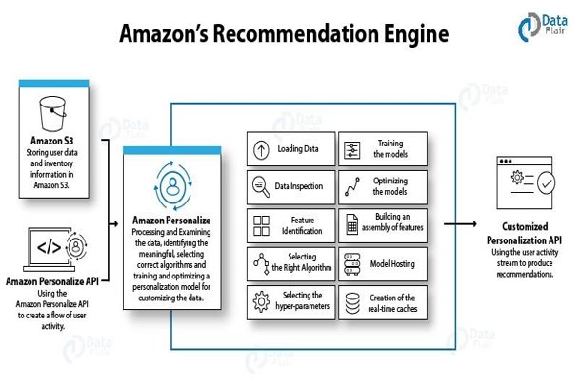
.
Use-Cases of Data Science

Slide 102
Weekly/Monthly Assignment
Explain the differences between supervised and unsupervised learning?
Why is Python used for Data Cleaning in DS?
Why is R used in Data Visualization?
What do you understand by linear regression?
What do you understand by logistic regression?
How is Data Science different from traditional application programming?
How are Data Science and Machine Learning related to each other?
Explain the difference between Data Science and Data Analytics?
Define the term deep learning?
10. List out the libraries in Python used for Data Analysis and Scientific Computations.

Slide 103
Weekly/Monthly Assignment
1. Explain about Big Data-Characteristics and applications.
2.Explain The building blocks of Hadoop?
3.Explain Why is Big Data Important?
4.What is data Analysis? Why is python used for data analysis?
5.What are the applications of machine Learning in data science?
6.What are the problems face when handling large data?
7.What do you understand with crowdsourcing analytics?
8. What do u mean by 5v’s of Big Data?
9. What are security challenges of Data Science?
10. How data science can be used in medical industry? Explain briefly?

Slide 104
Glossary Questions
1. Raw Data is original _______ of data.
2.Creating reproducible _______ is performed by Data Scientist.
3. Hadoop is a framework that works with a variety of related tools. Common cohorts include ____________.
4. __________characteristic of big data is relatively more concerned to data science.
5. ____________analytical capabilities are provided by information management company?
6. __________step is performed by data scientist after acquiring the data.
7. _______ are not sufficient to describe big data.
8. _____focuses on the discovery of (previously) unknown properties on the data.
9. As companies move past the experimental phase with Hadoop, many cite the need for additional capabilities, including _______________.
10. Data in ____ bytes size is called big data. ...

Slide 105
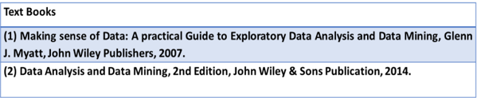
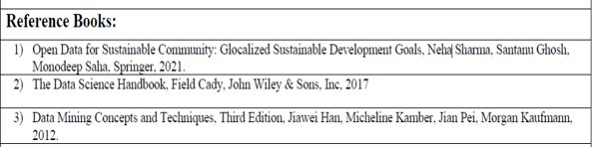
References

Slide 106
1. What is data science and its benefits?
2. Explain role and stages in data science?
3. What are the goals of data science?
4. What is data Analysis? Why is python used for data analysis?
5. Explain supervised and unsupervised machine Learning?
6. Why we need the machine Learning in data science?
7.Explain general techniques for handling volumes of data?
8.What are the problems face when handling large data?
9.Explain different stages of data Science?
10.Difference between data Analysis and analytics?
Expected Questions for End Semester Exam

